Slide 1
22CS026
DocEase
Doctor Appointment App
Team Members:
Bhuvesh Mittal(2210991450)
Daanushi Sharma(2210991469)
Supervised By: Ms. Preenu Mittan
Department of Computer Science and Engineering
Chitkara University, Punjab

Slide 2
TABLE OF CONTENTS
Introduction
Abstract
Problem Statement
Software Development Life Cycle Diagram
Technical Details
Key Features
Snapshots
Future scope
Conclusion
References/Links used

Slide 3
INTRODUCTION
In today's fast-paced healthcare environment, there is an increasing need for efficient patient management and streamlined communication among healthcare professionals. Our project, DocEase, addresses this need by creating a comprehensive digital platform that simplifies interactions between patients, doctors, and administrators.
The system provides:
Users (Patients): Access to a directory of doctors, the ability to view available time slots, and an easy-to-use appointment booking system.
Doctors: Tools to manage patient schedules, track upcoming appointments, and handle consultation fees efficiently.
Admins: Oversight of doctors' profiles, appointment schedules, and revenue management.
DocEase bridges the gap in healthcare management, ensuring a seamless experience for all stakeholders while saving time and effort.

Slide 4
ABSTRACT
DocEase is an innovative web-based platform designed to streamline healthcare management and doctor appointment booking. By providing distinct roles for patients, doctors, and administrators, it enables seamless scheduling, efficient fee management, and real-time tracking of appointments. The platform simplifies interactions between patients and healthcare providers, ensuring accessibility and convenience. With an intuitive user interface and role-specific functionalities, DocEase fosters an organized and patient-centric healthcare environment, representing a step towards modernizing healthcare operations and enhancing overall efficiency.

Slide 5

PROBLEM STATEMENT
Traditional methods of managing doctor appointments are inefficient, relying on manual processes and fragmented communication. Patients face difficulties booking appointments, doctors struggle to manage schedules, and administrators lack tools for effective oversight. The absence of a centralized platform leads to delays, errors, and disorganization.
This project addresses these challenges by creating a unified, user-friendly system that streamlines appointment booking, schedule management, and communication for patients, doctors, and administrators.

Slide 6
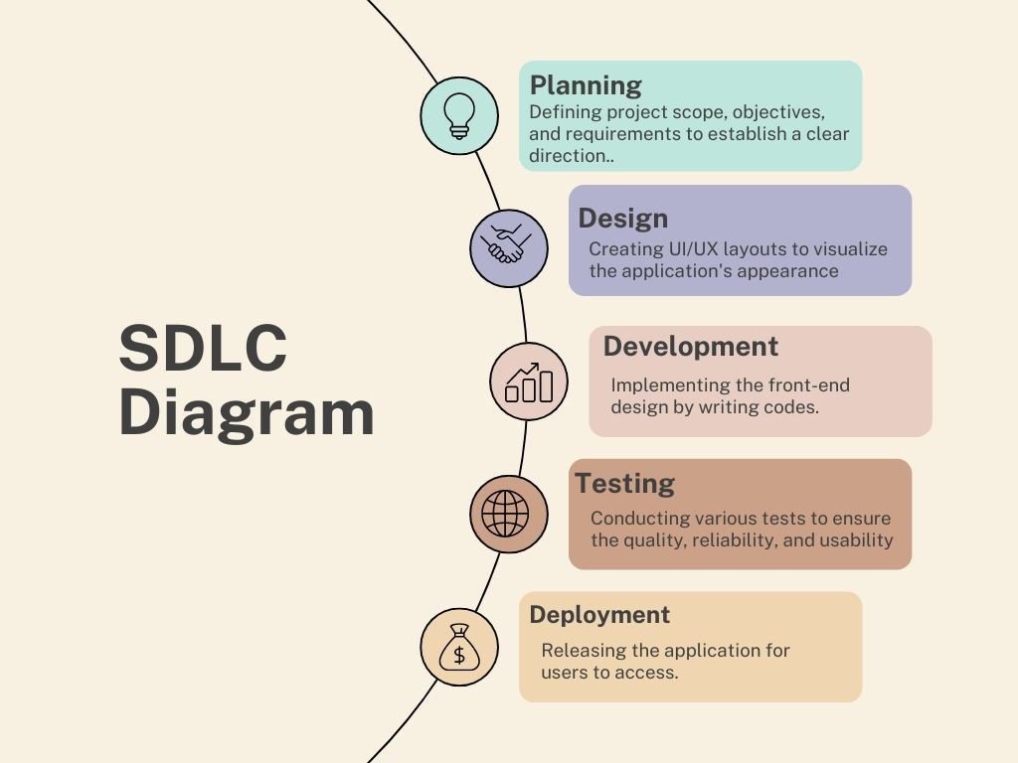
SDLC MODEL

Slide 7



TECHNICAL DETAILS
HTML:
Markup language for creating the structure of web pages.
Utilizes elements like <div>, <p>, <img> to organize content.
Forms for user input, with various input types like text, password, etc.
Semantics for accessibility and SEO.
TAILWIND CSS:
A utility-first CSS framework for styling HTML elements.
Simplifies layout design with classes for the box model: content, padding, border, and margin
Provides utility classes for positioning, display, flexbox, and grid layouts.
Enables responsive design through media query utilities.
REACTJS:
Allows dynamic rendering of HTML content based on real-time data.
Facilitates reusable components like headers, footers, and forms.
Supports conditional rendering to tailor content based on user roles or data.
Seamlessly integrates form handling for actions like login and data submissions.
Efficiently loops through arrays to render dynamic content such as notices, events, or appointments.

Slide 8



TECHNICAL DETAILS
Backend
MongoDB:
NoSQL database designed for handling large volumes of data.
Uses flexible, JSON-like documents to store data.
Supports dynamic schemas, allowing easy updates to data structure.
Provides horizontal scaling for managing distributed data.
Facilitates fast queries and indexing for efficient data retrieval.
Express:
Express is a minimal and flexible Node.js web application framework
that provides a robust set of features for web and mobile applications.
Express is a lightweight and flexible routing framework with minimal
core features meant to be augmented through the use of Express middleware modules.
Postman:
Postman is a global software company that offers an API platform for developers to design, build, test, and collaborate on APIs.

Slide 9

KEY FEATURES
User Roles:
Separate dashboards for admin, doctors, and patients, each with role-specific access and functionalities.
Appointment Management:
Doctors can manage availability and appointments, while patients can browse doctors and book appointments directly through the platform.
Revenue & Fee Management:
Doctors track their consultation fees and earnings, while admins monitor revenue and appointment data.
Patient-Doctor Interaction:
Doctors and patients can view appointment details, track consultation history, and manage appointment status updates.
Responsive Design:
Mobile-friendly layout, ensuring a seamless user experience across desktops, tablets, and smartphones.

Slide 10
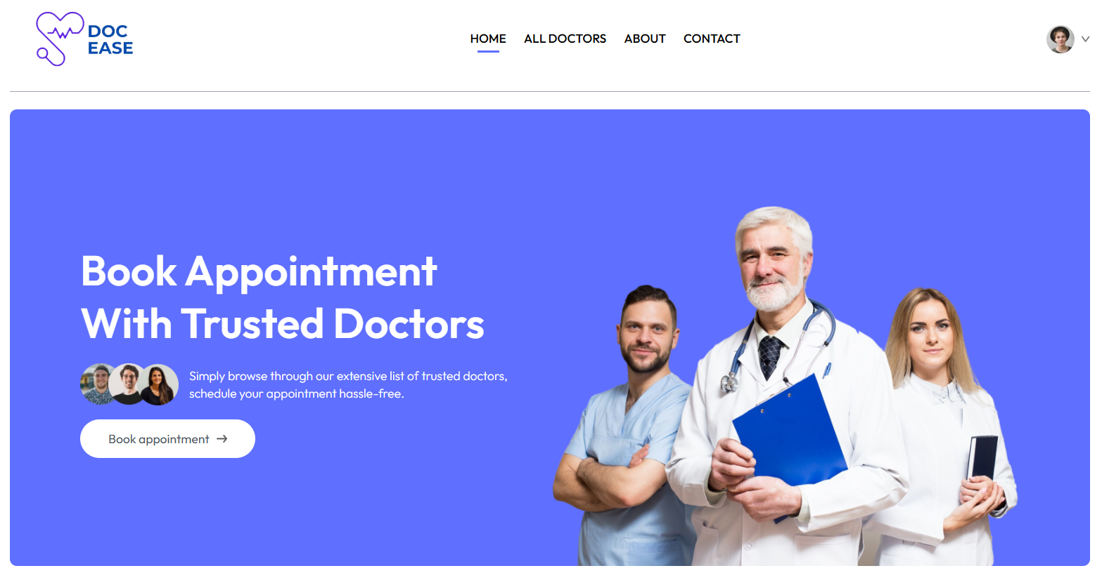
SNAPSHOTS
HOME PAGE :

Slide 11
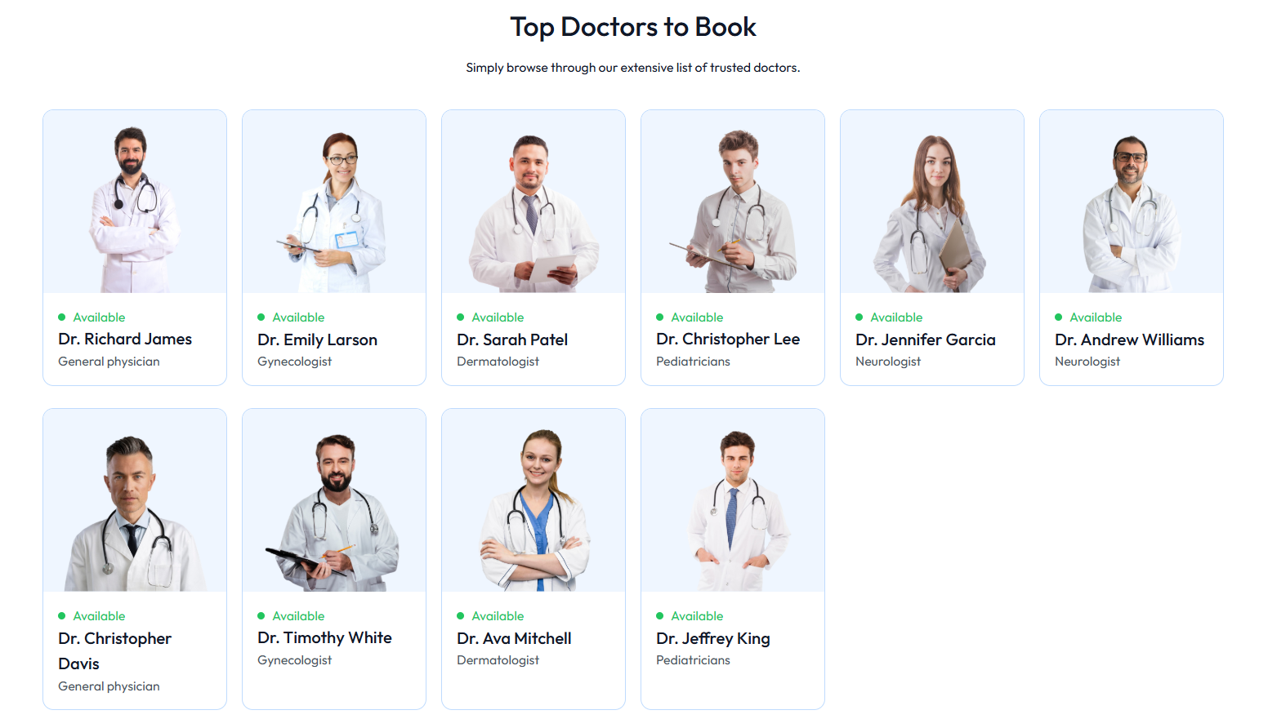
SNAPSHOTS

Slide 12
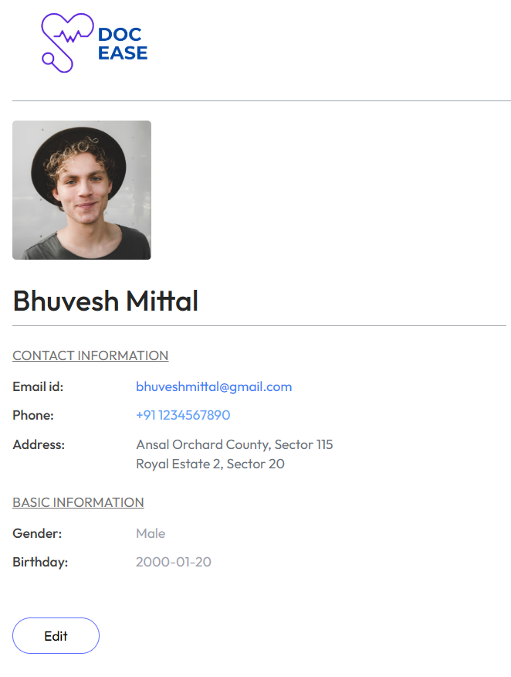
SNAPSHOTS
My Profile

Slide 13
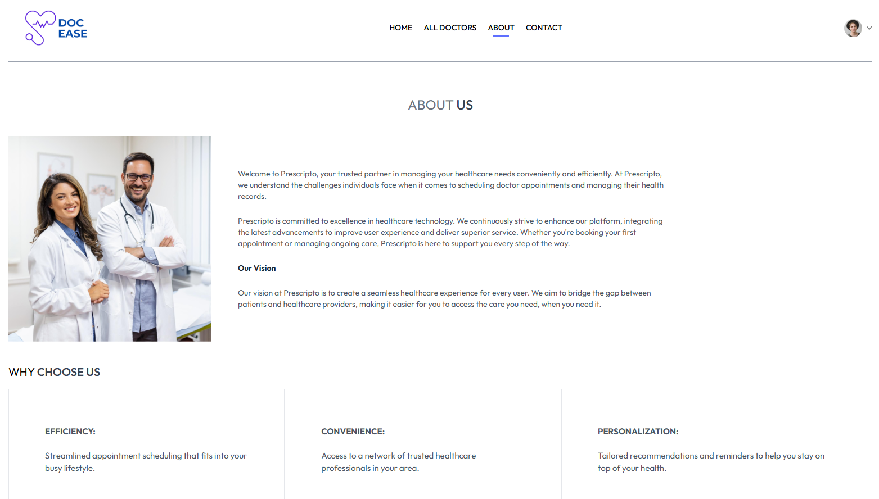
SNAPSHOTS
About-us :

Slide 14
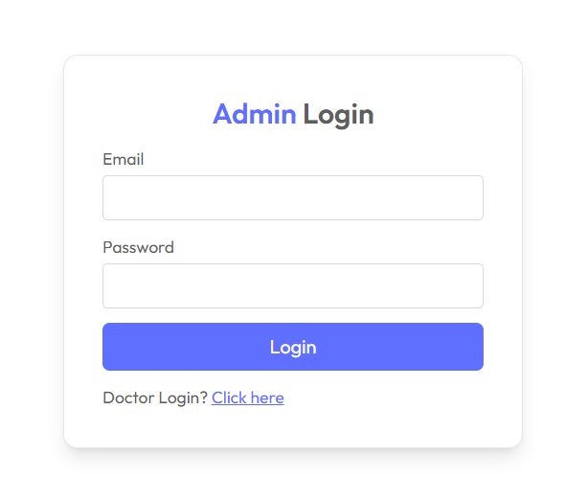
SNAPSHOTS
Admin Login:

Slide 15
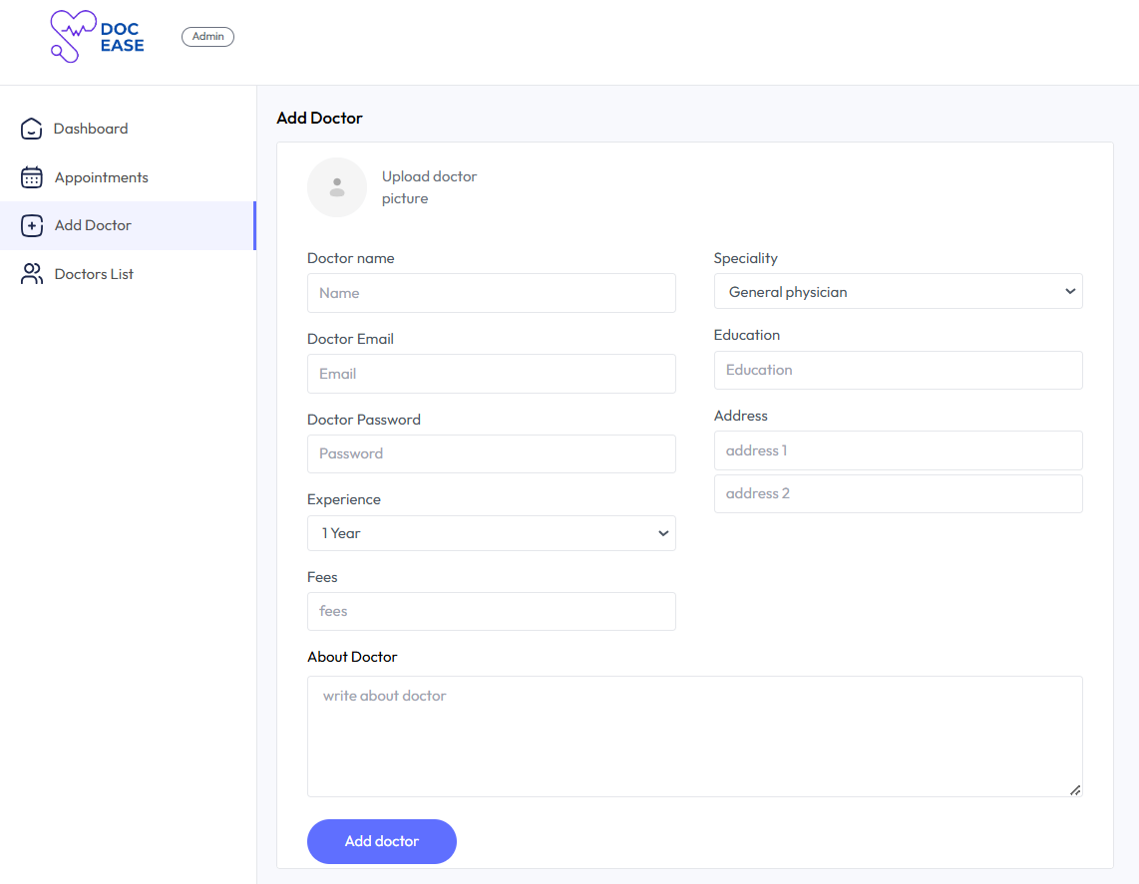
SNAPSHOTS
Add doctors by admin

Slide 16
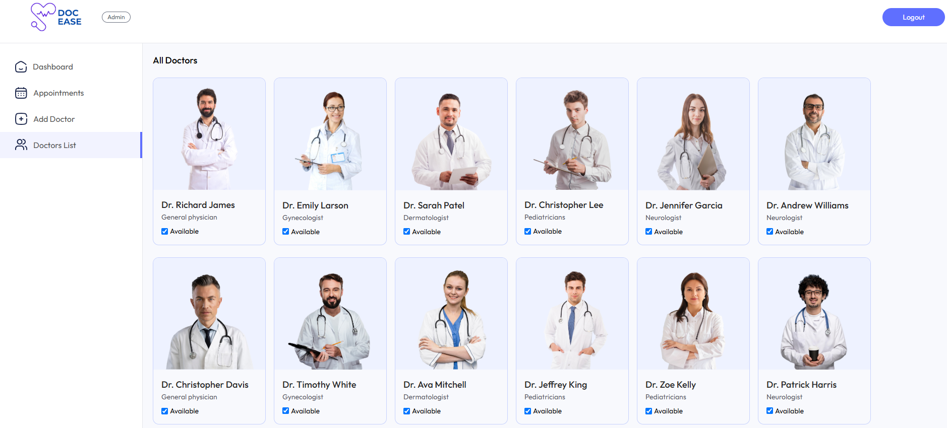
SNAPSHOTS
Doctors List:

Slide 17

FUTURE SCOPE
Advanced Analytics and Reporting: Admins will gain the ability to generate detailed reports on doctor availability and appointment trends, supported by data visualization tools for better insights.
Enhanced Security Measures: Future updates will include multi-factor authentication, data encryption, and role-based access to protect sensitive information, along with regular security audits.
Mobile Application Development: A mobile app for doctors, patients, and admins will provide access to features on-the-go, with push notifications for appointment reminders and updates.
Integration with External Systems: DocEase will integrate with third-party platforms like payment gateways and telemedicine tools, along with syncing schedules with Google Calendar.

Slide 18

CONCLUSION
The development of the DocEase platform is a significant advancement in simplifying the doctor appointment process. Using technologies like Node.js, Express.js, React, MongoDB, and Tailwind CSS, the system integrates essential features such as user-friendly appointment booking, doctor management, and role-based dashboards for admin, doctors, and patients.
The system offers seamless appointment scheduling, doctor availability management, and real-time updates. The platform is designed to be scalable, with plans for future enhancements like advanced reporting, mobile application development, and improved security measures such as multi-factor authentication.
With its intuitive interface and responsive design, DocEase ensures easy accessibility across devices, making healthcare management more efficient. As the platform evolves, it will continue to address user needs and expand its capabilities to offer a comprehensive healthcare solution.

Slide 19
References/Links used:
https://google.com/
https://youtube.com/
https://github.com/

Slide 20


